Slide 1
Artificial Intelligence: - Role of Learning - Expert systems
Santosh GSK
SENIOR DATA SCIENTIST
INDUSTRY EXPERT
OFFCAMPUS PROGRAM

Slide 2
Agent Architecture Recap
Simple Reflex Agent
Model based Agent
Goal based Agent
Utility based Agent
Learning based Agent

Slide 3
Agent Architecture Recap
Simple Reflex Agent
Model based Agent
Goal based Agent
Utility based Agent
Learning based Agent

Slide 4
Learning Agents
Agents that improve their performance by learning from their own experiences

Slide 5
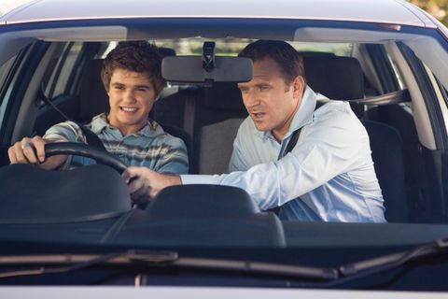
Learning Agents

Slide 6
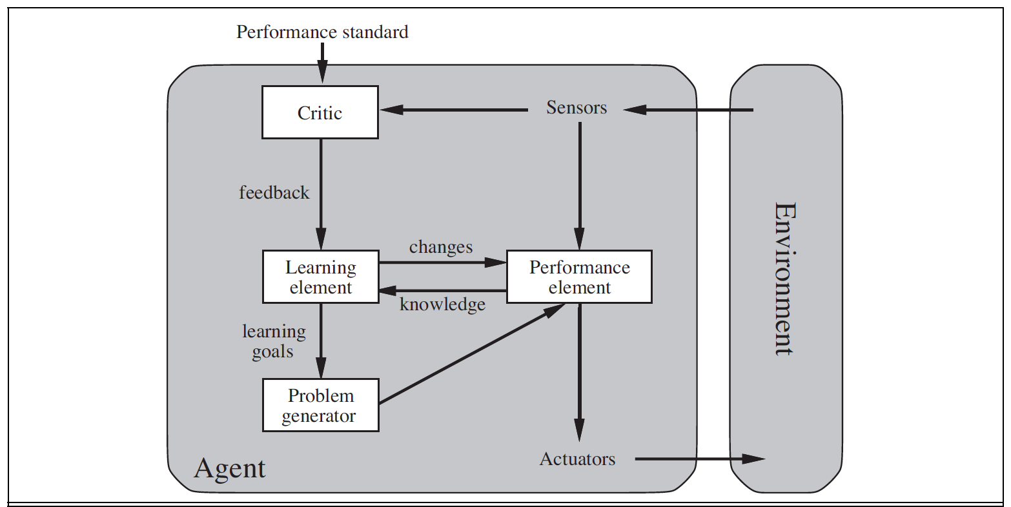
Learning Agents

Slide 7
Learning Agent Components
Performance Element – taking a decision of action based on percepts
Learning Element – Make the performance element select better actions such that the utility function is optimized
Critic – Provides feedback on the actions taken
Problem Generator – Make the Performance Element select sub-optimal actions such that you would learn from unseen actions

Slide 8
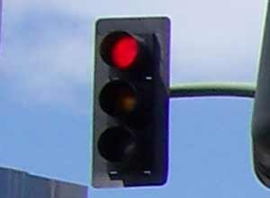
Performance Element
Input Percept
Output Action
APPLY BRAKE
Performance
Element

Slide 9
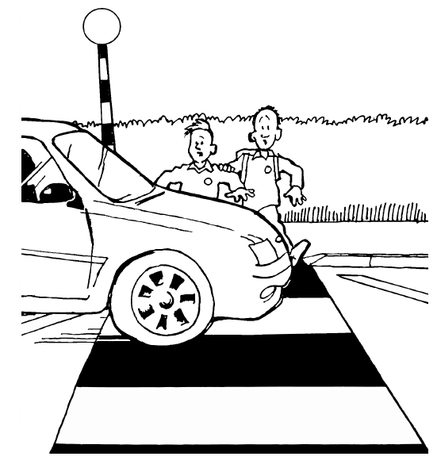
Critic
Resulting State
Feedback
Critic
-2

Slide 10
Learning Element
Input Percept
Output Action
APPLY BRAKE
Performance
Element
at 50 mts away
Force of 15k N
+ Critic Feedback -2

Slide 11
Learning Element
Input Percept
Output Action
APPLY BRAKE
Performance
Element*
at 50 mts away
Force of 17k N

Slide 12

Learning Element
Expected State

Slide 13
Problem Generator
Input Percept
Possible Actions
Selected Action
Brake
Change Gear to Lower
Change Gear to Higher
Accelerate
Steer left
Steer right
Random
Change Gear to Lower

Slide 14
Building a Learning Agent
Santosh GSK
SENIOR DATA SCIENTIST
INDUSTRY EXPERT
OFFCAMPUS PROGRAM

Slide 15

Performance Element - Components
A function mapping Percepts to Action
$$f\left(\begin{matrix}red signal, & distance\end{matrix}\right)=15k N brake$$

Slide 16
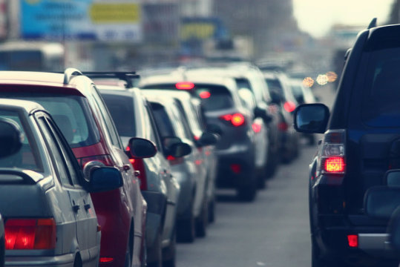
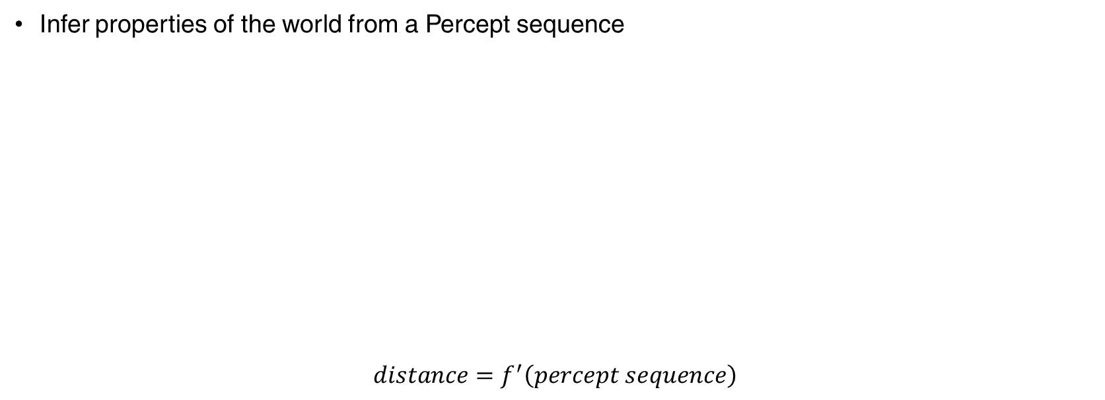
Performance Element - Components
Infer properties of the world from a Percept sequence
$$distance=f^{′}\left(percept sequence\right)$$

Slide 17
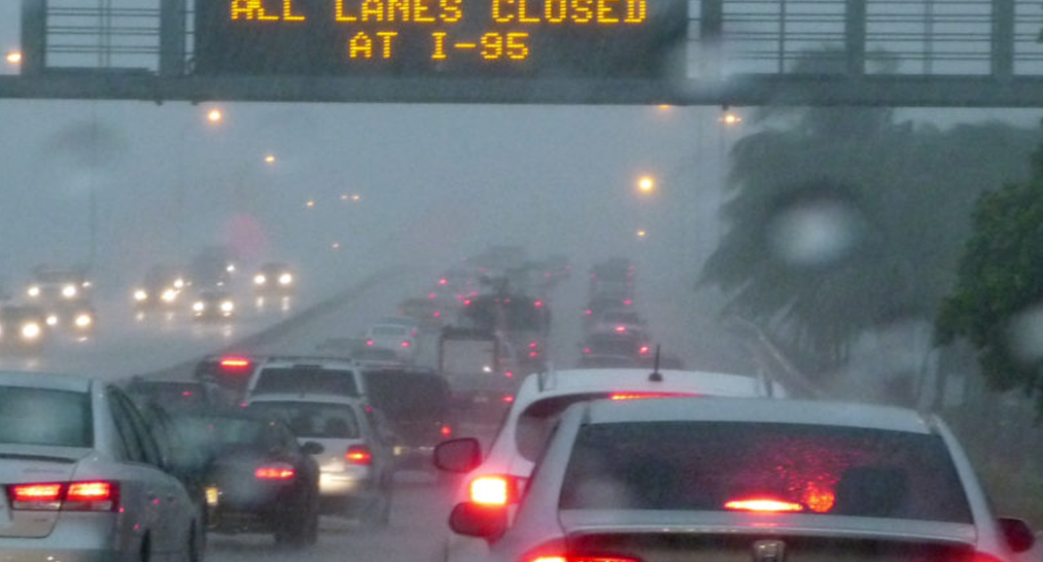
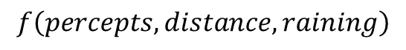
Performance Element - Components
Information about how the world evolves
$$f\left(percepts, distance, raining\right)$$

Slide 18
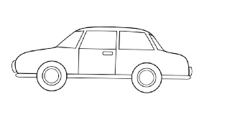

Performance Element - Components
Resulting state of possible actions
Zebra crossing
t= 0
Action 1: 15k N Brake
Zebra crossing
t= 0
Action 2: 18k N Brake
Zebra crossing
t= 0

Slide 19
Performance Element - Components
Utility function indicating the desirability of world states
Utility value
Zebra crossing

Slide 20
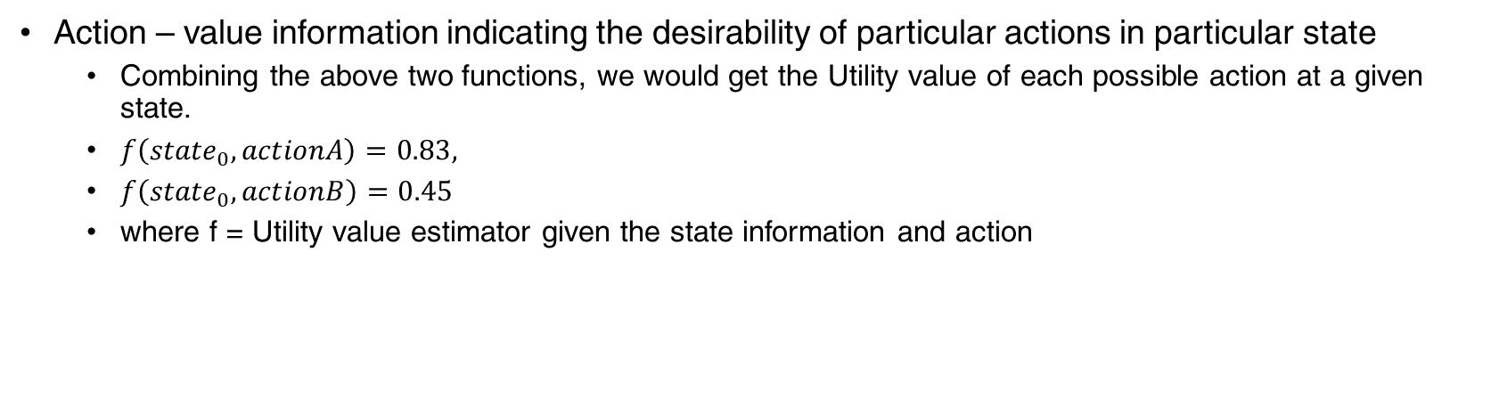
Performance Element - Components
Action – value information indicating the desirability of particular actions in particular state
Combining the above two functions, we would get the Utility value of each possible action at a given state.
$f\left({state}_{0},actionA\right)=0.83,$
$f\left({state}_{0}, actionB\right)=0.45$
where f = Utility value estimator given the state information and action

Slide 21
Performance Element - Components
Goal information determining the utility value of resulting states
Goal
Higher
Utility
Lower
Utility

Slide 22
Performance Element - Components
A function mapping Percepts to Action
Infer properties of the world from a Percept sequence
Information about how the world evolves
Information about resulting state of possible actions
Utility function indicating the desirability of world states
Action – value information indicating the desirability of particular actions in particular state
Goal information determining the utility value of resulting states

Slide 23
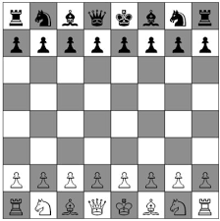
Performance Element - Components
A function mapping Percepts to Action
Information about how the world evolves
Action – value information indicating the desirability of particular actions in particular state
Goal information determining the utility value of resulting states

Slide 24

Performance Element - Components
Spam Classifier
A function mapping Percepts to Action
SPAM
HAM

Slide 25
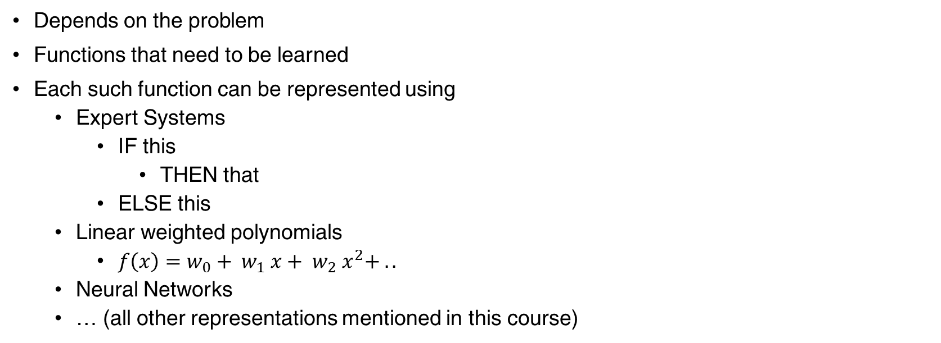
Performance Element - Components
Depends on the problem
Functions that need to be learned
Each such function can be represented using
Expert Systems
IF this
THEN that
ELSE this
Linear weighted polynomials
$f\left(x\right)=w_{0}+ w_{1} x+ w_{2} x^{2}+ ..$
Neural Networks
… (all other representations mentioned in this course)

Slide 26
Critic
Supervised Learning
When agent receives immediate feedback with the correct outcome
E.g., Agent’s predicted action is brake action with 15k N but the feedback says the action should have been 17k N
Here, the goal of learning – predicting the right action

Slide 27
Critic
Reinforcement Learning
When agent receives feedback about the outcome is good or not but doesn’t provide the correct action needed
E.g., Agent’s predicted action is brake action with 15k N but the feedback says the value of resulting state is -2 but doesn’t provide the correct action

Slide 28
Learning Element Design
Depends on four aspects
Components of performance element which needs to be improved
Their representative function
Feedback
Prior information
Existing knowledge about the problem,
E.g., to decelerate the vehicle, Brake and Changing to Lower Gear has better chances compared to Accelerate or Changing direction.

Slide 29
Example
Task: Predict whether I would enjoy water sport on a given day based on weather conditions
Sky | AirTemp | Humidity | Wind | Water | Forecast | EnjoySport?
Sunny | Warm | Normal | Strong | Warm | Same | Yes
Sunny | Warm | High | Strong | Warm | Same | Yes
Rainy | Cold | High | Strong | Warm | Change | No
Sunny | Warm | High | Strong | Cool | Change | Yes

Slide 30
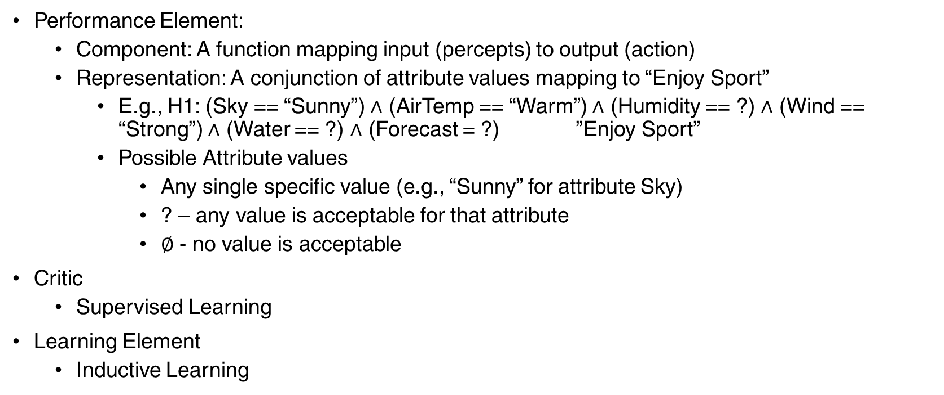
Example: Enjoy Sport
Performance Element:
Component: A function mapping input (percepts) to output (action)
Representation: A conjunction of attribute values mapping to “Enjoy Sport”
E.g., H1: (Sky == “Sunny”) $∧$ (AirTemp == “Warm”) $∧$ (Humidity == ?) $∧$ (Wind == “Strong”) $∧$ (Water == ?) $∧$ (Forecast = ?) ”Enjoy Sport”
Possible Attribute values
Any single specific value (e.g., “Sunny” for attribute Sky)
? – any value is acceptable for that attribute
$∅$ - no value is acceptable
Critic
Supervised Learning
Learning Element
Inductive Learning

Slide 31
Inductive Learning
An input data point is a pair <x, f(x)>
Where x is the vector of attribute values, f(x) is the true outcome for those attribute values
E.g., <Sunny, Warm, Normal, Strong, Warm, Same> -> “EnjoySport”
The task of Inductive Learning:
Given enough samples of <x, f(x)>
Return a function h that approximates f, such that h(x) = f(x)
The function h is called hypothesis

Slide 32
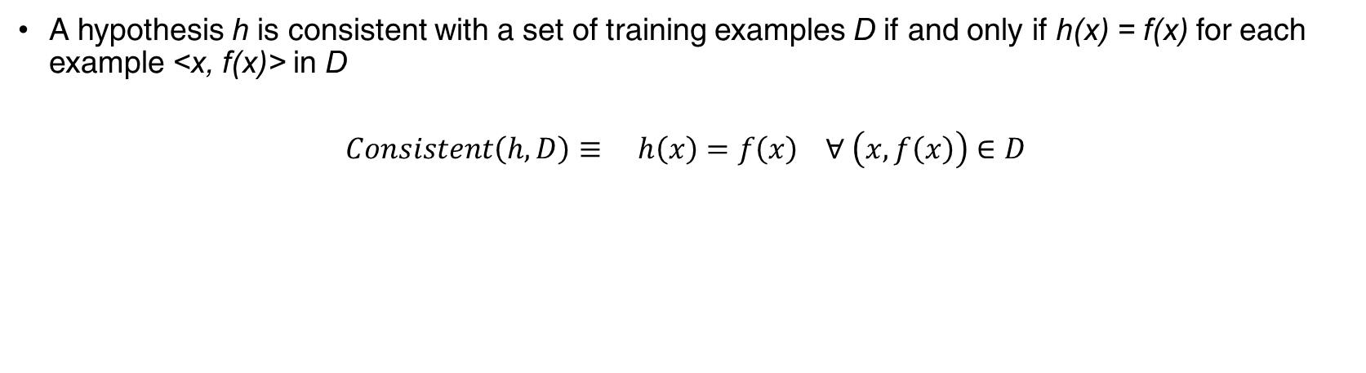
Consistent Hypothesis
A hypothesis h is consistent with a set of training examples D if and only if h(x) = f(x) for each example <x, f(x)> in D
$$Consistent\left(h, D\right)≡ h\left(x\right)=f\left(x\right) ∀ \left(x, f\left(x\right)\right)∈D$$

Slide 33
Inductive Bias
Several hypothesis h₁, h₂, … can approximate the true function f
Inductive Bias: Preferring a hypothesis that can generalize beyond the observed training data

Slide 34
Example: Enjoy Sport
Sky | AirTemp | Humidity | Wind | Water | Forecast | EnjoySport?
Sunny | Warm | Normal | Strong | Warm | Same | Yes
Sunny | Warm | High | Strong | Warm | Same | Yes
Rainy | Cold | High | Strong | Warm | Change | No
Sunny | Warm | High | Strong | Cool | Change | Yes
Possible consistent hypothesis:
H0: <Sunny, ?, ?, ?, ?, ?> -> Enjoy Sport
H1: <Sunny, Warm, ?, ?, ?, ?> -> Enjoy Sport

Slide 35
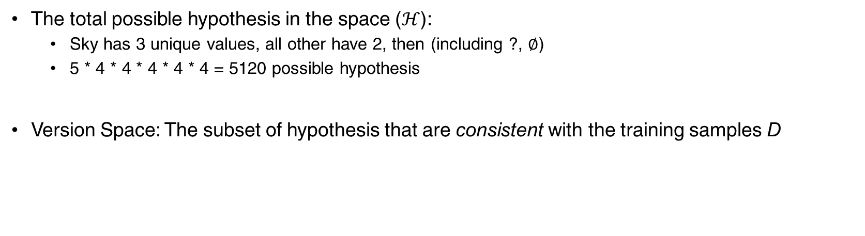
Example: Enjoy Sport
The total possible hypothesis in the space ($ℋ$):
Sky has 3 unique values, all other have 2, then (including ?, $∅$)
5 * 4 * 4 * 4 * 4 * 4 = 5120 possible hypothesis
Version Space: The subset of hypothesis that are consistent with the training samples D

Slide 36
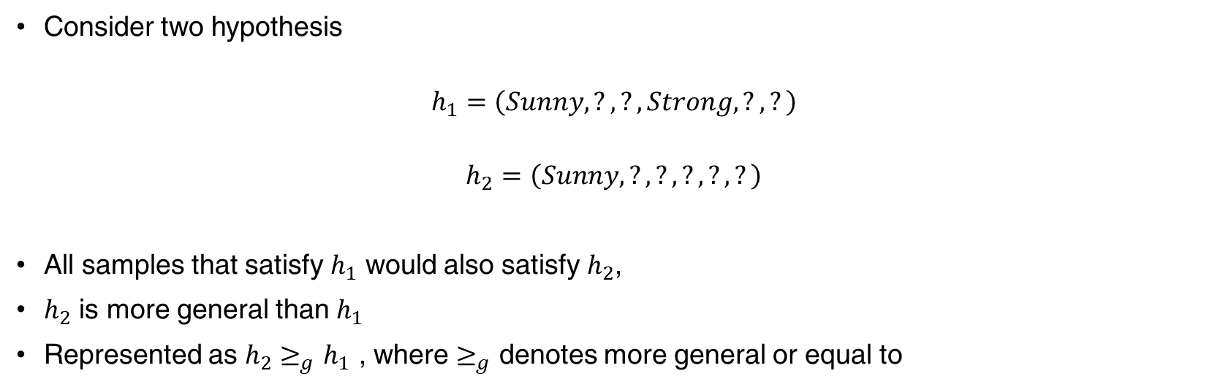
General-to-Specific Hypothesis Ordering
Consider two hypothesis
$$h_{1}=\left(Sunny, ?, ?, Strong, ?, ?\right)$$
$$h_{2}=\left(Sunny, ?, ?, ?, ?, ?\right)$$
All samples that satisfy $h_{1}$ would also satisfy $h_{2}$,
$h_{2}$ is more general than $h_{1}$
Represented as $h_{2}≥_{g}h_{1}$ , where $≥_{g}$ denotes more general or equal to

Slide 37
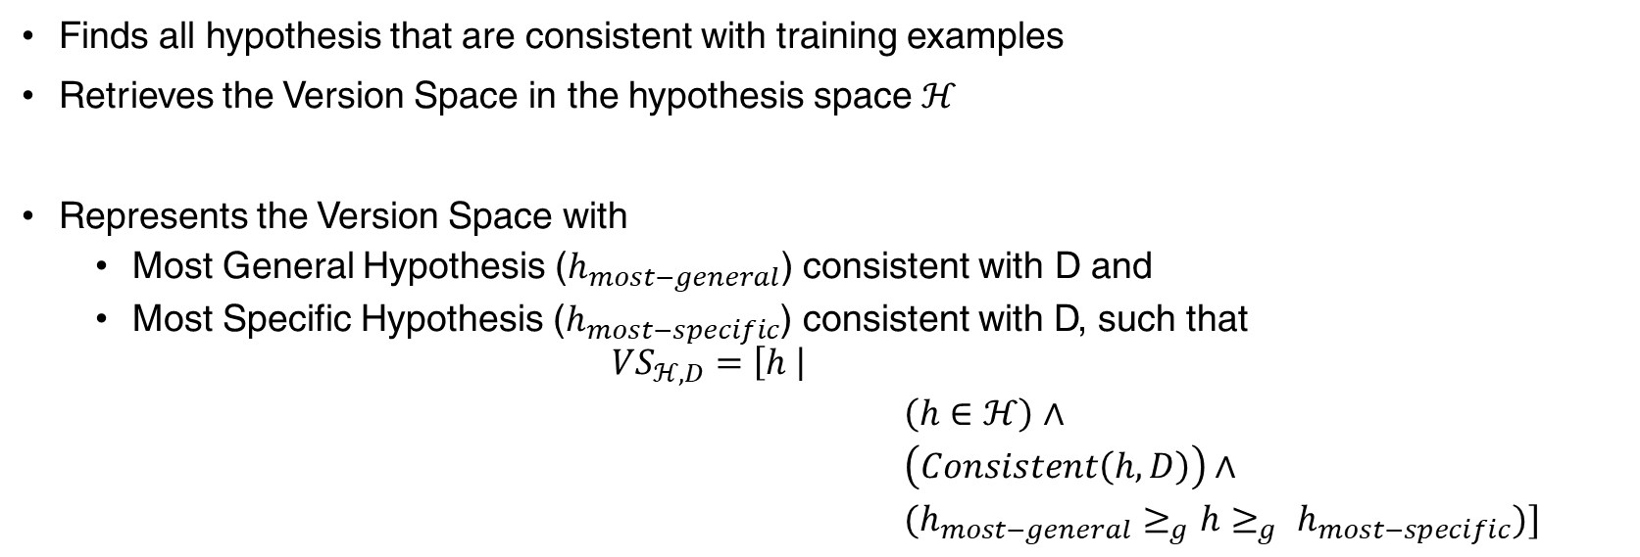
Candidate Elimination Algorithm
Finds all hypothesis that are consistent with training examples
Retrieves the Version Space in the hypothesis space $ℋ$
Represents the Version Space with
Most General Hypothesis ($h_{most−general}$) consistent with D and
Most Specific Hypothesis ($h_{most−specific}$) consistent with D, such that
$${VS}_{ℋ, D}=\left[h \right|$$
$\left(h∈ℋ\right)∧$
$\left(Consistent\left(h, D\right)\right)∧$
$(h_{most−general}≥_{g}h≥_{g} h_{most−specific})]$

Slide 38
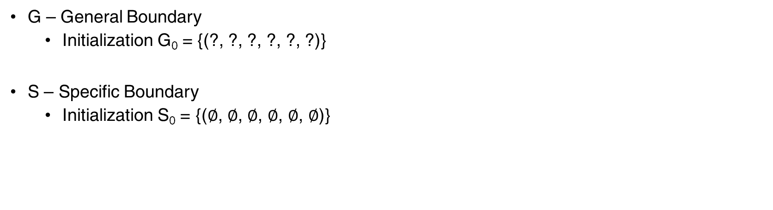
Candidate Elimination Algorithm
G – General Boundary
Initialization G₀ = {(?, ?, ?, ?, ?, ?)}
S – Specific Boundary
Initialization S₀ = {($∅$, $∅$, $∅$, $∅$, $∅$, $∅$)}

Slide 39
Candidate Elimination Algorithm
For each training example d, do
If d is a positive example
Remove from G any hypothesis inconsistent with d
For each hypothesis s in S that is not consistent with d
Remove s from S
Add to S all minimal generalizations h of s such that
h is consistent with d, and some member of G is more general than h
Remove from S any hypothesis that is more general than another hypothesis in S

Slide 40
Candidate Elimination Algorithm
For each training example d, do
If d is a negative example
Remove from S any hypothesis inconsistent with d
For each hypothesis g in G that is not consistent with d
Remove g from G
Add to G all minimal generalizations h of g such that
h is consistent with d, and some member of S is more specific than h
Remove from G any hypothesis that is more specific than another hypothesis in G

Slide 41
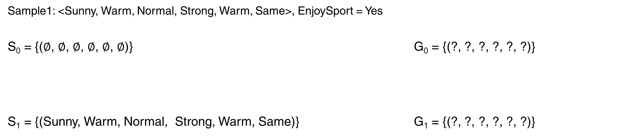
Candidate Elimination Algorithm
Sample1: <Sunny, Warm, Normal, Strong, Warm, Same>, EnjoySport = Yes
S₀ = {($∅$, $∅$, $∅$, $∅$, $∅$, $∅$)} G₀ = {(?, ?, ?, ?, ?, ?)}
S₁ = {(Sunny, Warm, Normal, Strong, Warm, Same)} G₁ = {(?, ?, ?, ?, ?, ?)}

Slide 42
Candidate Elimination Algorithm
Sample 2: <Sunny, Warm, High, Strong, Warm, Same>, EnjoySport = Yes
S₁ = {(Sunny, Warm, Normal, Strong, Warm, Same)} G₁ = {(?, ?, ?, ?, ?, ?)}
S₂ = {(Sunny, Warm, ?, Strong, Warm, Same)} G₂ = {(?, ?, ?, ?, ?, ?)}

Slide 43
Candidate Elimination Algorithm
Sample 3: <Rainy, Cold, High, Strong, Warm, Change>, EnjoySport = Yes
S₂ = {(Sunny, Warm, ?, Strong, Warm, Same)} G₂ = {(?, ?, ?, ?, ?, ?)}
S₃ = {(Sunny, Warm, ?, Strong, Warm, Same)} G₃ = {(Sunny, ?, ?, ?, ?, ?),
(?, Warm,?, ?, ?, ?),
(?, ?, ?, ?, ?, Same)}

Slide 44
Candidate Elimination Algorithm - Exercise
Sample 4: <Sunny, Warm, High, Strong, Cold, Change>, EnjoySport=Yes
S₃ = {(Sunny, Warm, ?, Strong, Warm, Same)} G₃ = {(Sunny, ?, ?, ?, ?, ?),
(?, Warm,?, ?, ?, ?),
(?, ?, ?, ?, ?, Same)}
? ?

Slide 45
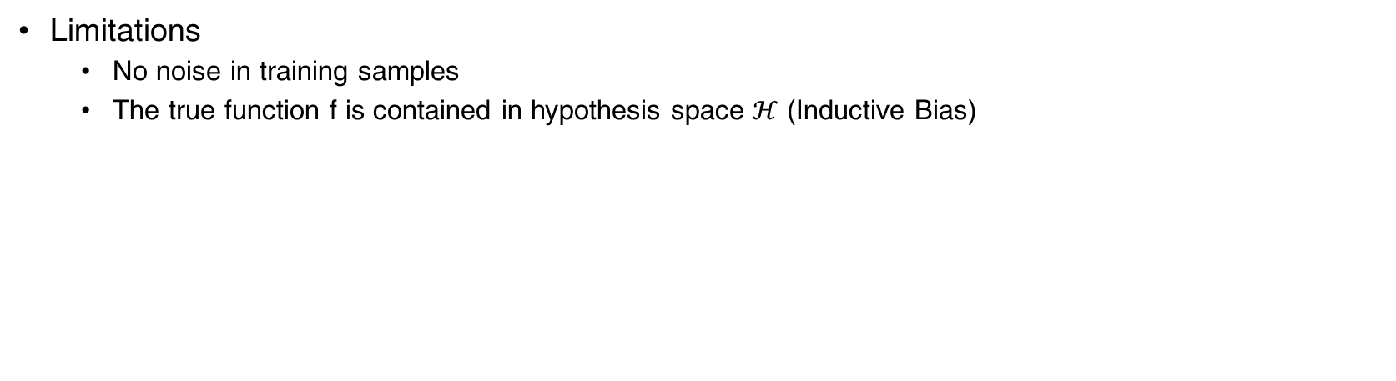
Candidate Elimination Algorithm
Limitations
No noise in training samples
The true function f is contained in hypothesis space $ℋ$ (Inductive Bias)

Slide 46

Human Experts
US: 1 radiologist for every 10,000
India: 1 radiologist for every 1,00,000¹
Many diseases can be positively impacted if diagnosed early²
Lack of radiologists delay diagnosis
1 - https://www.ncbi.nlm.nih.gov/pmc/articles/PMC2747434/
2 – Early diagnosis saves lives, cuts treatment costs

Slide 47
Expert Systems
Solution:
Encode the expert’s knowledge into machine readable representation
Using that knowledge, build systems that can solve problems which would otherwise require a human expert
Buzz Words
Expert’s Knowledge
Representation
Solving problems

Slide 48
Expert Systems: Knowledge
Expert’s Knowledge
Set of facts, rules, procedures and heuristics used by experts in solving problems
Facts are declarative statements that are true. E.g., Paris is the capital of France.
Rules are set of guidelines that need to be adhered. E.g., Do not disclose gender in an ultrasound scan. (in India)
Procedures are a series of steps followed to solve a task. E.g., To start a car, first put the key in, turn it clockwise, etc.
Heuristics are the practical ways of solving problems gained with experience. E.g., a car mechanic might know the problem with a car just based on engine sound.
Not to be confused with data, E.g., doctor treating a patient uses Knowledge & Data

Slide 49
Expert System: Knowledge Representation
Knowledge Representation
Expert Knowledge is represented in Symbols that can be understood by programs
Representation schemes: Predicate Logic, Frames and associative networks, Fuzzy Logic, Object oriented methods

Slide 50
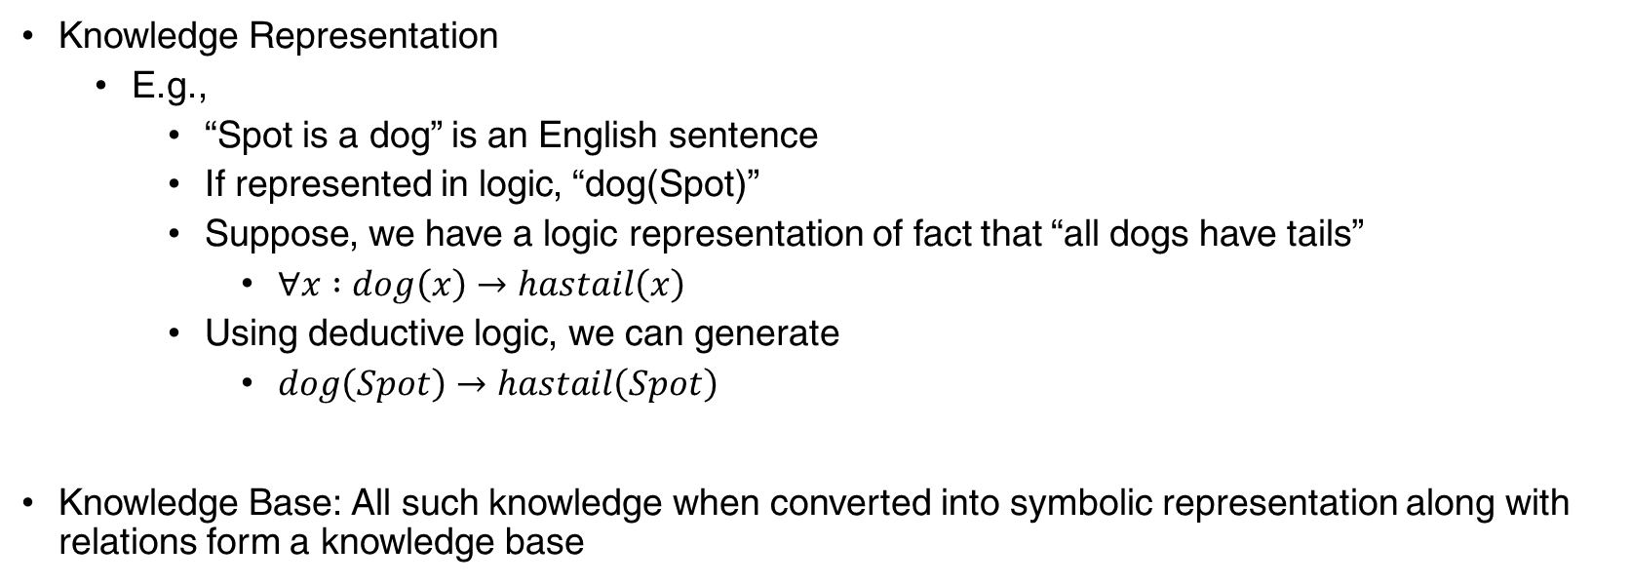
Expert System: Knowledge Representation
Knowledge Representation
E.g.,
“Spot is a dog” is an English sentence
If represented in logic, “dog(Spot)”
Suppose, we have a logic representation of fact that “all dogs have tails”
$∀x :dog\left(x\right)→hastail\left(x\right)$
Using deductive logic, we can generate
$dog\left(Spot\right)→hastail\left(Spot\right)$
Knowledge Base: All such knowledge when converted into symbolic representation along with relations form a knowledge base

Slide 51
Expert System: Sample Knowledge Base
Sample Knowledge Base of Family Relationships (in LISP):
Facts are represented as a1, a2, a3
E.g., a1 (male bob) , i.e., bob is a male
Rules are represented as r1, r2, r3
E.g., r1 ((husband ?x ?y)) → (male ?x) , i.e., if ?x is husband of ?y, then ?x is male
r2 ((mother ?x ?y) (husband ?z ?x)) → (father ?z ?y) , i.e., the two facts on LHS (mother an d husband) when satisfied in conjunction then RHS is true

Slide 52
Expert System: Sample Knowledge Base
( (a1 (male bob))
(a2 (female sue))
(a3 (male sam))
(a4 (male bill))
(a5 (female pam))
(r1 ((husband ?x ?y))
→ (male ?x))
(r2 ((wife ?x ?y))
→ (female ?x))
(r3 ((wife ?x ?y))
→ (husband ?y ?x)) …
.. (r4 ((mother ?x ?y) (husband ?z ?x))
→ (father ?z ?y))
(r5 ((father ?x ?z) (mother ?y ?z)
→ (husband ?x ?y))
(r6 ((father ?x ?z) (mother ?y ?z)
→ (wife ?y ?x))
(r7 ((father ?x ?y) (father ?y ?z)
→ (grandfather ?x ?z)) )

Slide 53
Expert System: Inference
Inference: The act of using the symbolic representation of knowledge in deriving conclusions given user’s input
Inferring process done in three stages:
Match – User’s input is compared with facts and rules in Knowledge base
Select – All appropriate facts and rules matched are put together and one of the rules is selected. Criteria can be most-recent, #conjuncts on left or smallest rule number.
Execute – The selected rule is executed and resulting action is displayed to user

Slide 54
Expert System: Inference
Example 1:
User’s Input - (father bob sam) (mother sue sam)
Match step: r5 and r6 rules are matched and their conclusions (husband bob sue) and (wife sue bob) are put in a conflict set
Select step: Simply select the first match, i.e., (husband bob sue)
Execute step: Trigger a message to user and probe further questions and repeat
Forward Chaining: The input is matched from LHS and the RHS is executed

Slide 55
Expert System: Inference
Example 2:
Suppose, we added (a6 (father sam bill)) and (a7 (father bill pam)) to knowledge base
User Input: Who is the grandfather of Pam? → (grandather ?x pam)
Match step: (r7 ((father ?x ?y) (father ?y ?z) → (grandfather ?x pam))
(father ?x ?y) (father ?y pam)
Substituting with a7 → (father ?x bill) (father bill pam)
Substituting with a6 → (father sam bill) (father bill pam)
(grandfather sam pam)
Backward Chaining: RHS is instantiated first, then the LHS becomes sub goals and they are matched with facts

Slide 56
Expert System: Knowledge Acquisition
Acquisition and encoding of requisite domain knowledge
Expert sources can be experts in a field, journal articles, texts, reports, etc.
Tedious job, can take several years sometimes and also costly
Experts sometimes cannot articulate their problem solving process

Slide 57
Expert System – Knowledge Acquisition
Knowledge Engineers – intermediaries between experts and systems
Conduct extensive interviews with domain experts
During the interview, experts are asked to solve problems and explain their solution
Codes the knowledge into rules or some other representation
These encoded rules are tested, reviewed and errors are corrected till sufficient accuracy
Domain
Expert
Knowledge
Engineer
System
Builder
Knowledge
Base

Slide 58
Expert System – Explainability
Builds trust in the system when it can explain its reasoning process
Two possible explanations
How did the system reach a particular conclusion
Why would a system need a particular information in order to complete a step
Behavior of an expert system can be explained by tracing the chain of rules that were fired

Slide 59
Expert System - Explainability
How Query?
How did you reach this conclusion?
The sequence of rules that led to the conclusion are displayed to the user
E.g., Why is Sam the grandfather of Pam?
Pam’s father is Bill and Bill’s father is Sam. As per Rule no. 7, it infers that Sam is the grandfather of Pam.

Slide 60
Expert System - Explainability
Why Query?
When the systems prompts a request for information, user can ask why such information is needed
Reasoning backwards to answer two questions
What higher level reasoning can be answered if the system has this missing information?
What other info does the system already have that makes this missing information useful?
E.g., In diagnosing a car that doesn’t start, a system might ask for the status of distributor spark.
User can ask - why would the system need distributor spark’s status information?
System would reply – to determine if the problem can be isolated to the ignition system.
Important when asking for clinical tests which can be costly

Slide 61
Expert Systems – Maintenance
Most difficult task: maintaining a consistent but complete set of rules in a knowledge base
Very easy ways of allowing knowledge to be modified to keep the knowledge base consistent
Intuitive User Interface with User testing the current version of knowledge base and suggesting changes

Slide 62
Thank You!
In our next session:

